Slide 1
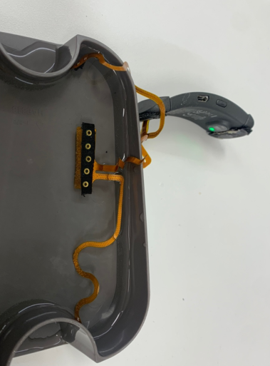
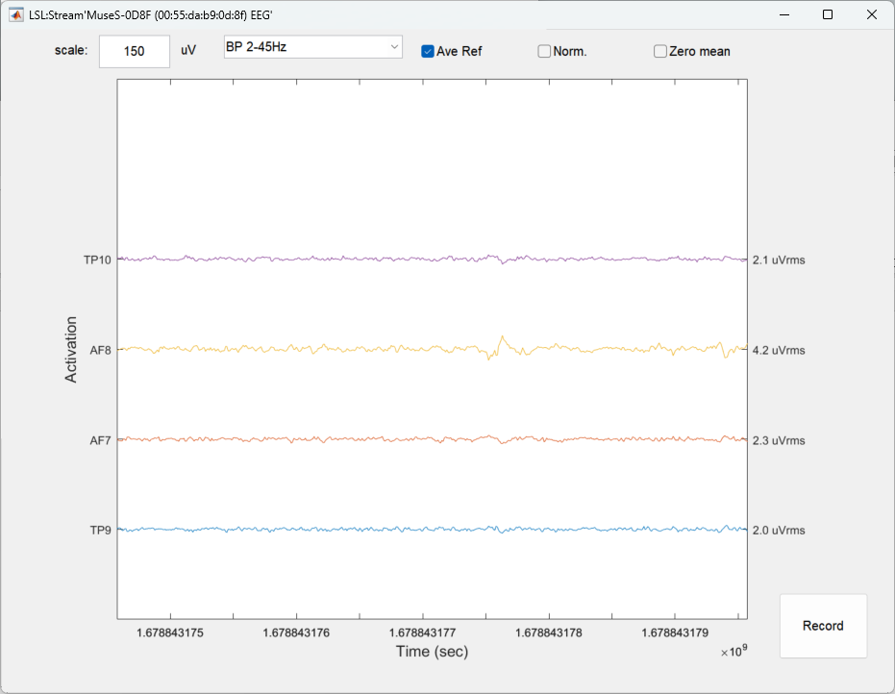
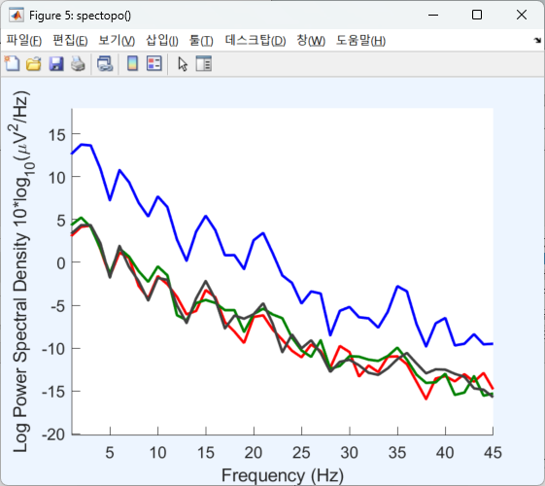
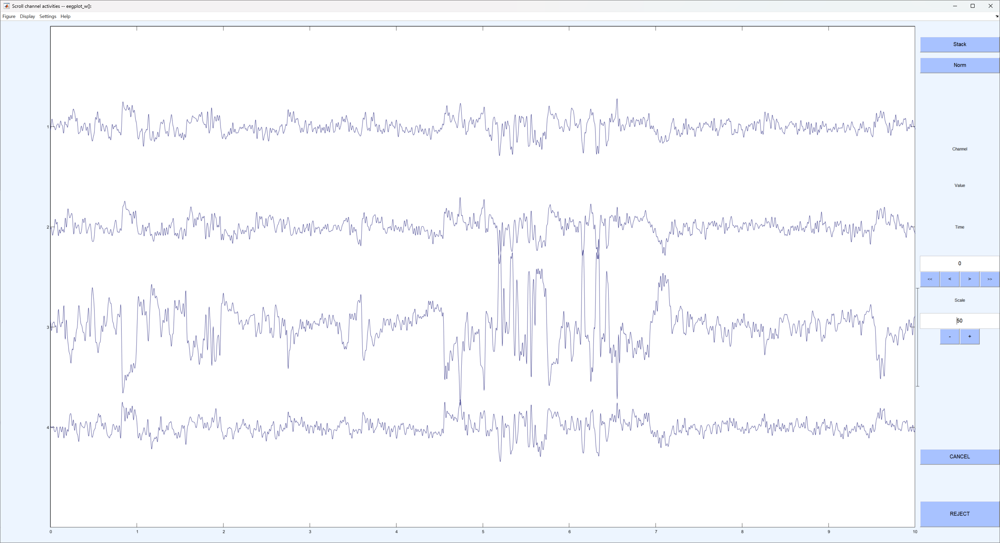
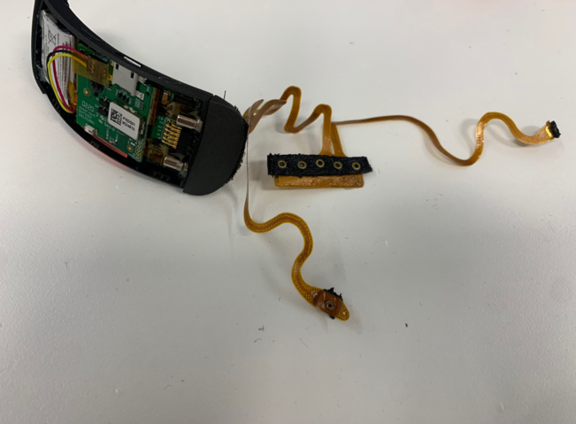
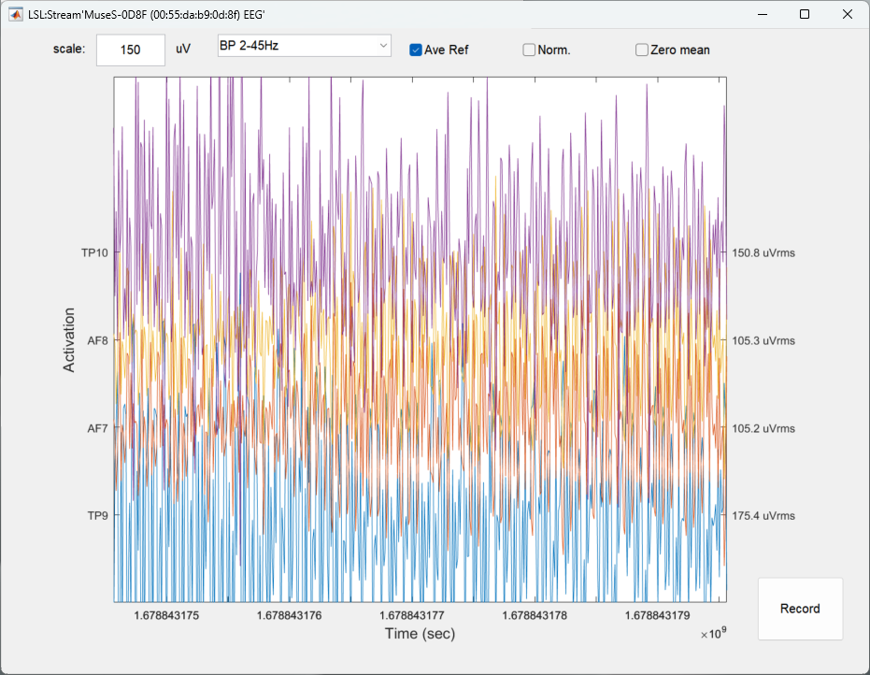
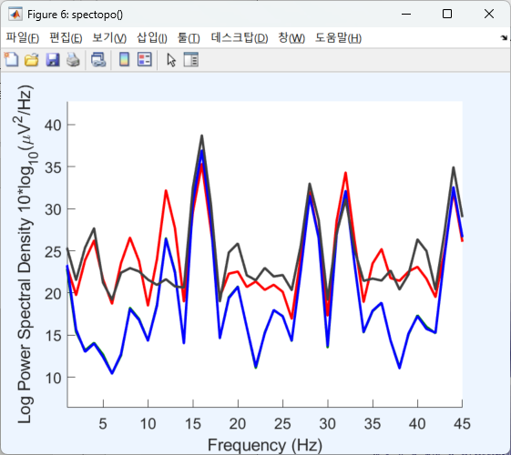
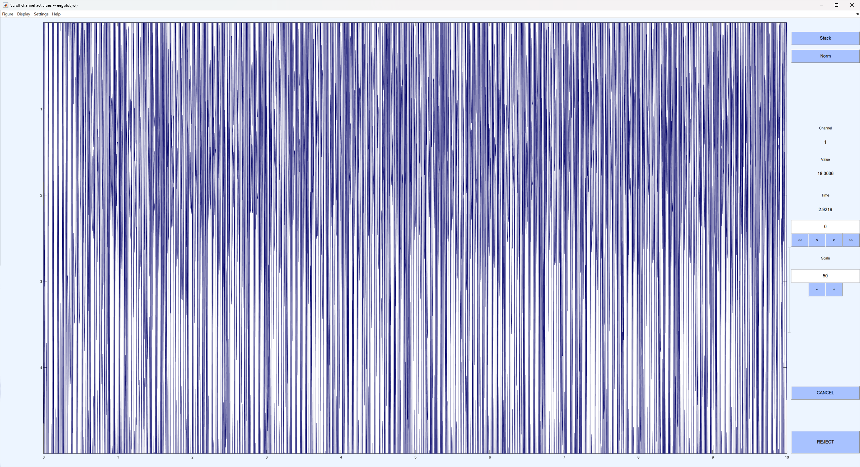
Muse 비교
식염수
Live stream (CAR)
FFT Spectrum 1~45Hz (CAR)
1~45Hz (CAR)
Live stream (CAR)
FFT Spectrum 1~45Hz (CAR)
1~45Hz (CAR)
외부 노출

Slide 2
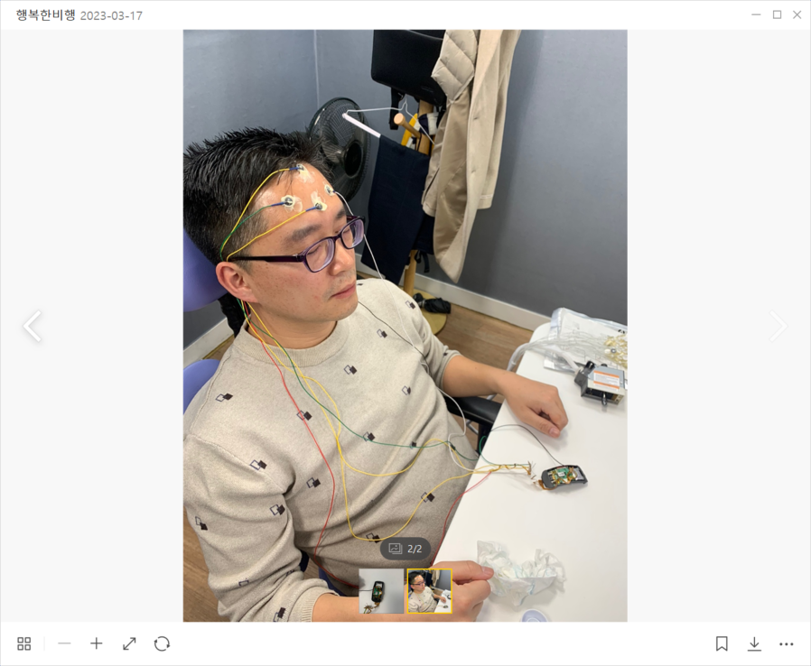
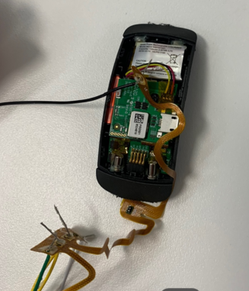
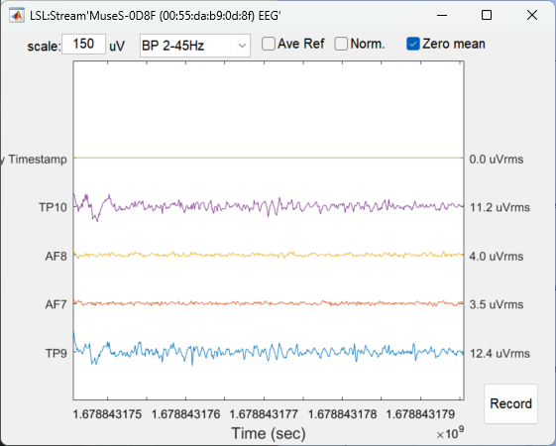
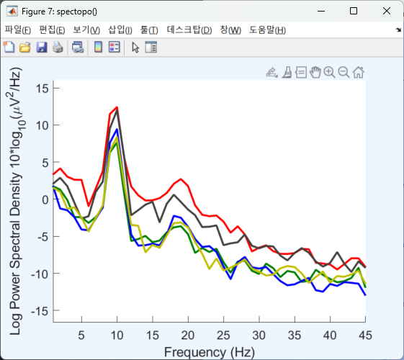
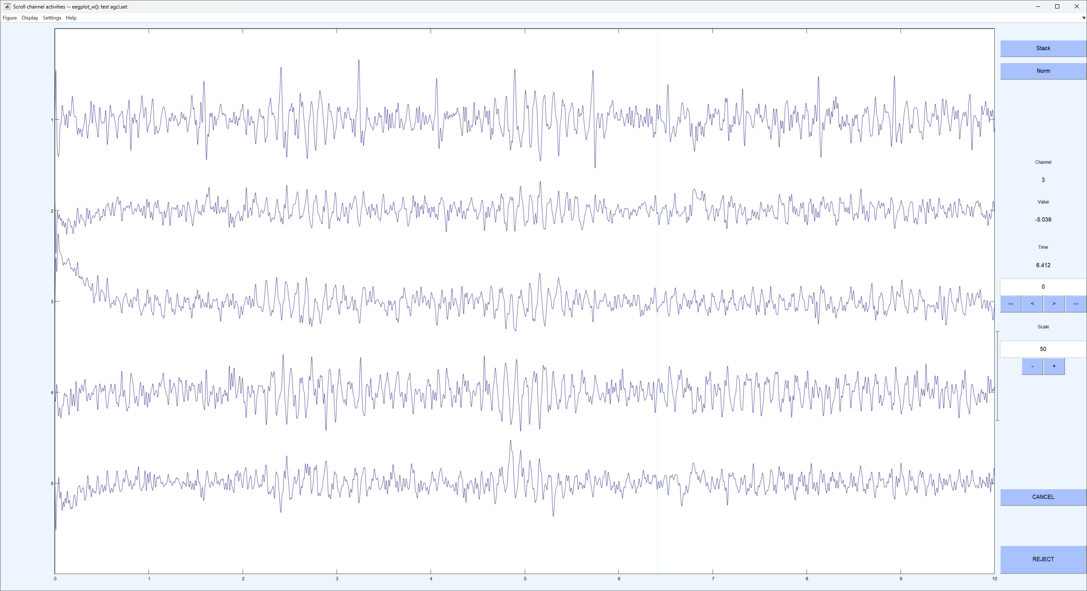
Muse 비교
식염수
Live stream (CAR)
FFT Spectrum 1~45Hz (CAR)
1~45Hz (CAR)
Live stream (CAR)
FFT Spectrum 1~45Hz (CAR)
1~45Hz (CAR)
회로직접연결

